Slide 1
FAKE NEWS PREDICTON
Submitted By:-
Rishabh Johri
Data Scientist- Intern

Slide 2
ACKNOWLEDGEMENT:-
It is a great pleasure to express my gratitude to Team Flip Robo, for giving me the opportunity to work on a interesting project, which helped me in improving my knowledge, coding skills and my analysation skills.
Team Flip Robo also gave me opportunity to build PowerPoint Presentation and Project Report, which will help me to share steps taken while building the entire model. It has helped me in deciding about the future prospects of various Data Science fields. Now, I will explain the understanding of the project through this report.

Slide 3
INTRODUCTION
Business Problem Framing :-
Fake News Filtering
Fake news has become one of the biggest problems of our age. It has a serious impact on our online as well as offline discourse. One can even go as far as saying that, to date, fake news poses a clear and present danger to western democracy and stability of the society.
Fake news simple meaning is to incorporate information that leads people to the wrong path. Nowadays, fake news is spreading like water and people share this information without verifying it. This is often done to further or impose certain ideas and is often achieved with political agendas.
For media outlets, the ability to attract viewers to their websites is necessary to generate online advertising revenue. So, it is necessary to detect the fake news.

Slide 4
Conceptual Background of the Domain Problem :-
The main goal of the assignment is to show how you could design a Fake news filtering system from basics.
In this project, we are using some machine learning and Natural language processing libraries like NLTK, re (Regular Expression) and Scikit Learn.
Natural Language Processing :-
Machine learning data only works with numerical features so we have to convert text data into numerical columns. Here, we have to Pre-process the text and that is called natural language processing. In-Text Pre-processing, we are cleaning our text by stemming, lemmatization, removing stopwords, removing special symbols and numbers, etc. After cleaning the data, we have to feed this text data into a vectorizer which will convert this text data into numerical features.

Slide 5
Review of Literature :-
There are two datasets one for Fake news and one for true news. In true news, there is 21417 news, and in Fake news, there is 23481 news. I have inserted one label column 0 for Fake news and one for true news:
- Title: Headlines of the news.
- Text: Content of the news.
- Subject: Subject of the news.
- Date: Date of the news.
- Label: News is True(1)/False(0)

Slide 6
Motivation for the Problem Undertaken :-
The authenticity of Information has become a major issue affecting businesses and society, both for printed and digital media. On social networks, the reach and effects of information spread occur at such a fast pace and so amplified that distorted, inaccurate, or false information acquires a tremendous potential to cause real-world impacts, within minutes, for millions of users. Recently, several public concerns about this problem and some approaches to mitigate the problem were expressed.
The sensation of not-so-accurately eye-catching and intriguing headlines aimed at retaining the attention of audiences to sell information has persisted all throughout the history of all kinds of information broadcast. On social networking websites, the reach and effects of information spread are however significantly amplified and occur at such a fast pace, that distorted, inaccurate, or false information acquires a tremendous potential to cause real impacts within minutes for millions of users.

Slide 7
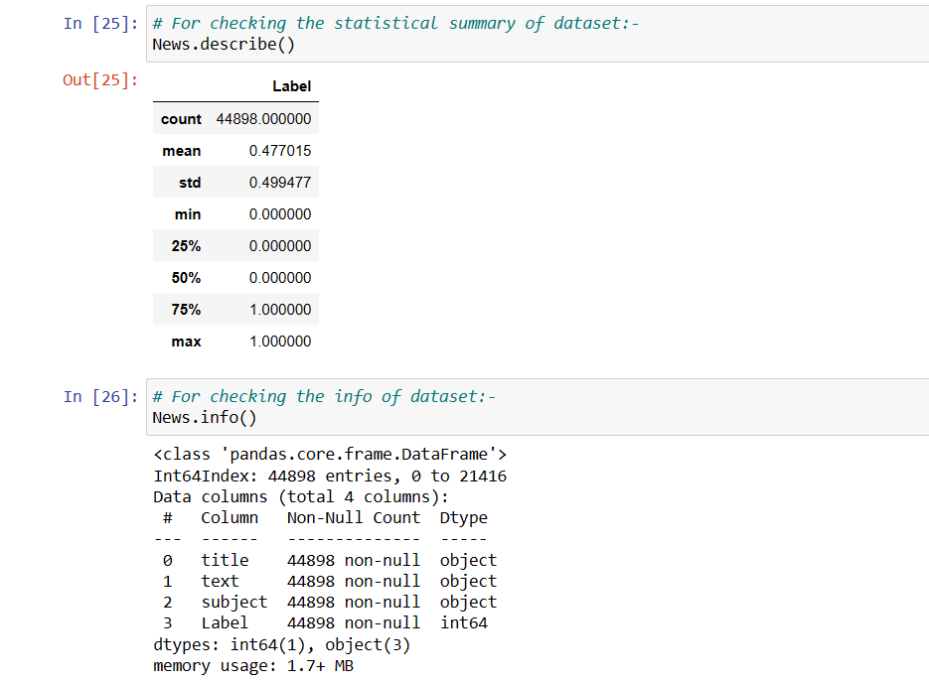
Analytical Problem Framing :-
Mathematical / Analytical Modelling of the Problem :-
For fetching the information and description of the dataset :-

Slide 8
Data Sources and their formats :-
There are two datasets one for Fake news and one for true news. In true news, there is 21417 news, and in Fake news, there is 23481 news.

Slide 9
Data Preprocessing :-
In Data pre-processing, I have done various steps to clean the dataset, as the dataset contains the comment that are in object datatype, which cannot be read by the model, so before giving the features to the model I had to convert that object datatype to meaningful data and that can be understand by the model, so for this I have used the NLP (Natural Processing Language).
“Natural language processing (NLP) refers to the branch of computer science and more specifically, the branch of artificial intelligence (AI) concerned with giving computers the ability to understand text and spoken words in the same way in which human beings can.”

Slide 10
Data Inputs- Logic- Output Relationships :-
Here I have Used TF-IDF Vectorizer to encode the comments section.
TfidfVectorizer is the base building block of many NLP pipelines. It is a simple technique to vectorize text documents i.e. transform sentences into arrays of numbers and use them in subsequent tasks.

Slide 11
Some Hardware and Software Requirements and Tools Used :
Anaconda-navigator
jupyter notebook
matplotlib-inline =0.1.6
Numpy =1.23.2

Slide 12
Model/s Development and Evaluation :-
_ Identification of possible problem-solving approaches (methods) :-
EDA
Description
Visualization
Data cleaning
Data Pre-processing (NLP)
Word Cloud
Encoding
Model Building
Select the best model
Cross-Validation.

Slide 13
Testing of Identified Approaches (Algorithms) :-
Algorithms used for the training and testing:
AdaBoost Classifier.
GradientBoosting Classifier.
RandomForest Classifier.
Decision Tree Classifier.

Slide 14
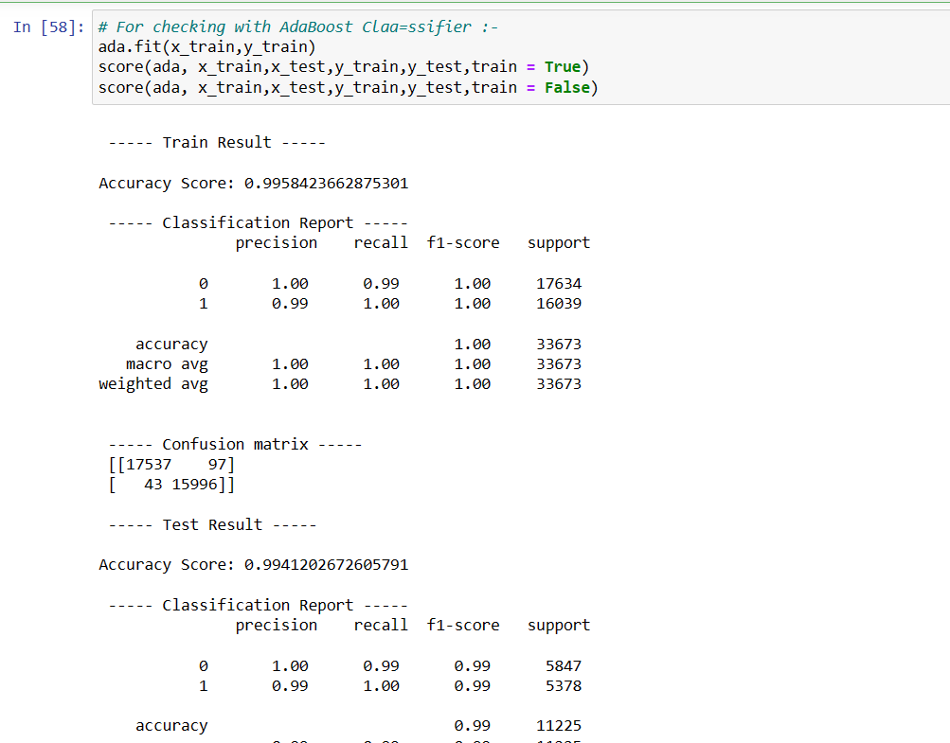
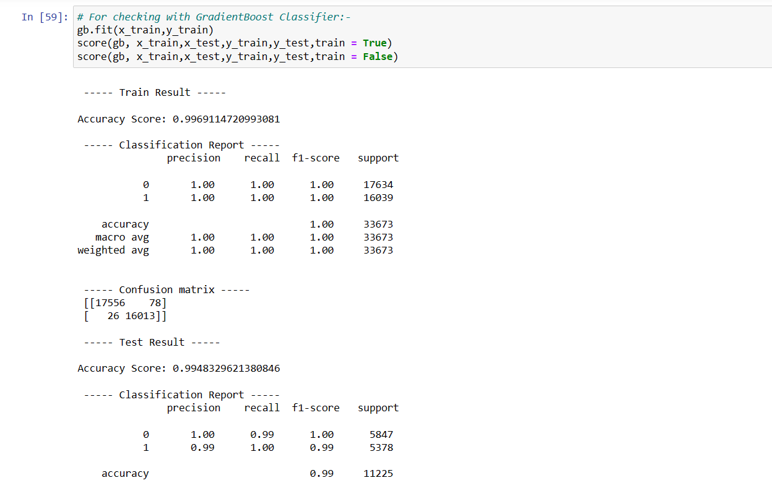
Model Building and Performance :-

Slide 15
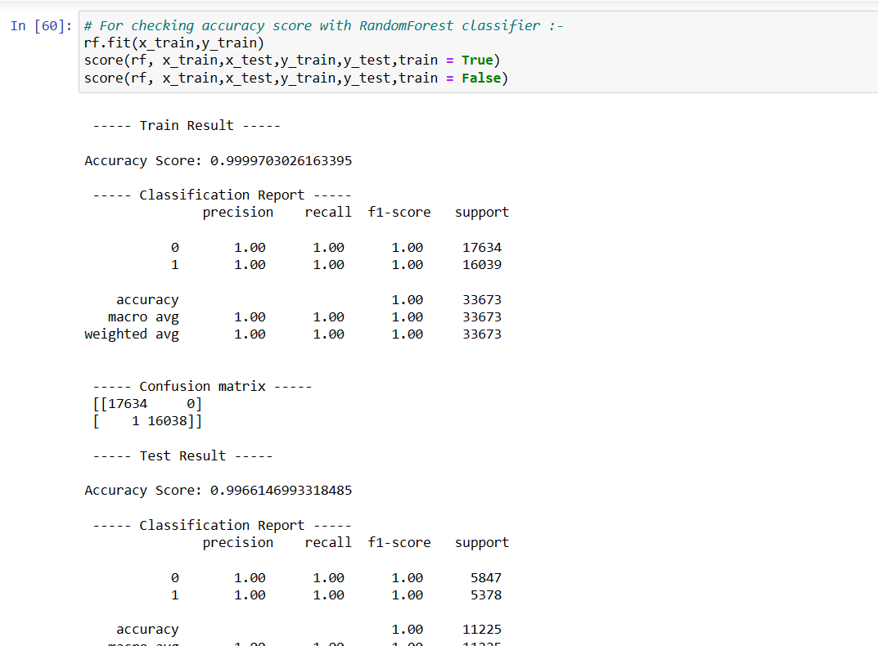
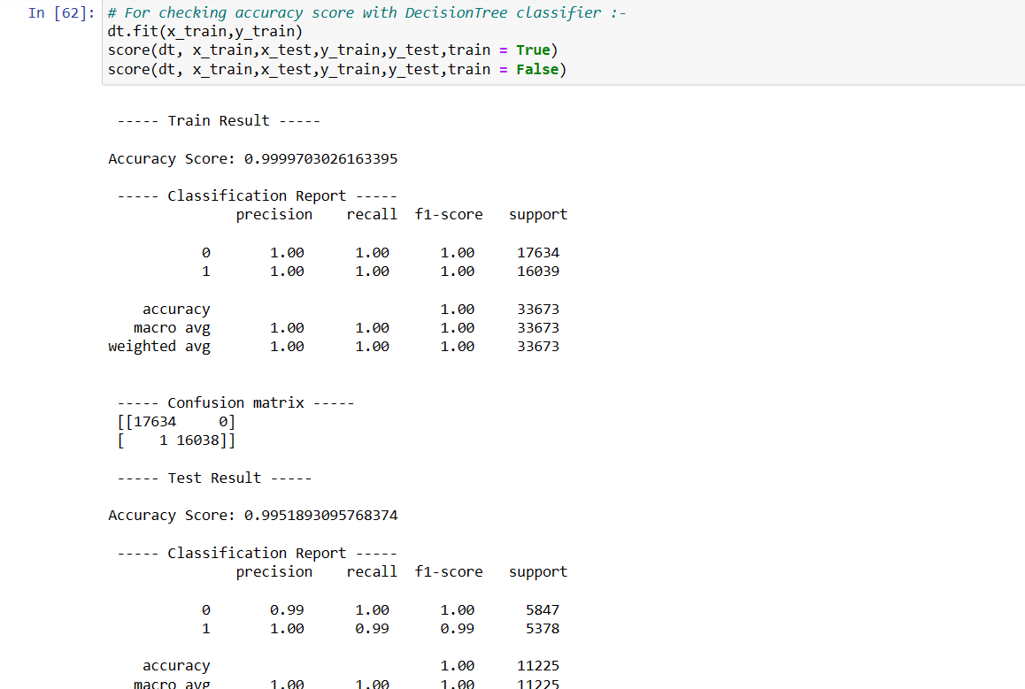

Slide 16
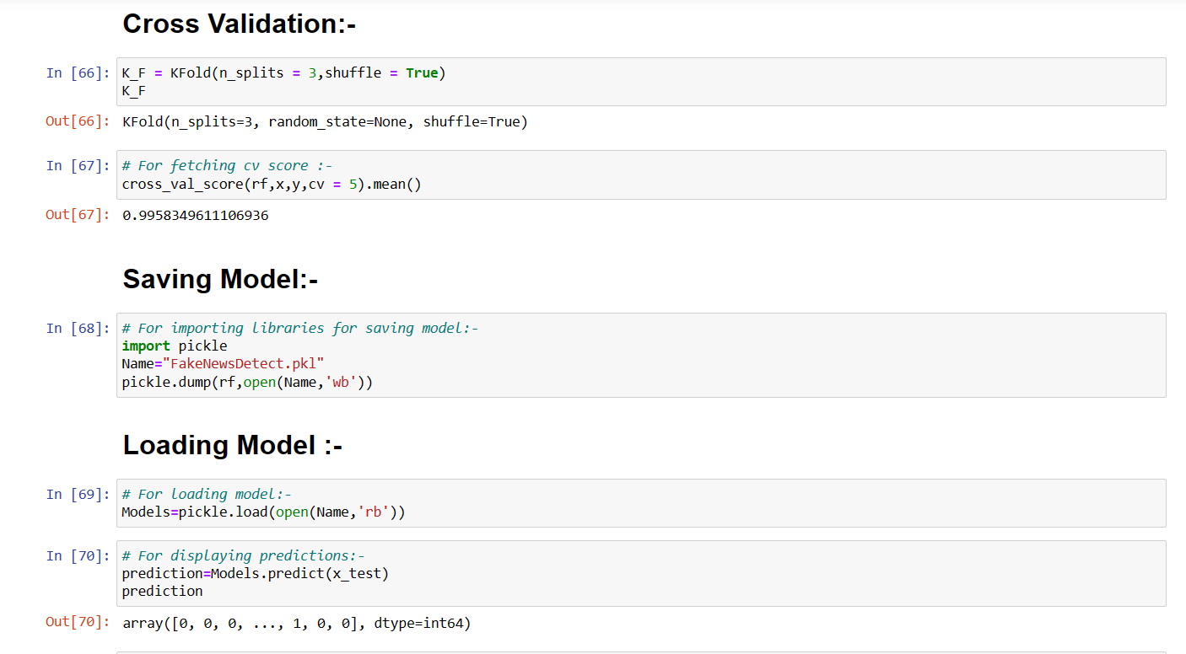
Cross Validation along with Saving and Loading Model:-

Slide 17
Interpretation of the Results :-
RandomForest Classifier is giving the best result as compared to others.
CONCLUSION :-
Apply computing theory, languages, and algorithms, as well as mathematical and statistical models, and the principles of optimization to appropriately formulate and use data analyses. Formulate and use appropriate models of data analysis to solve hidden solutions for business-related challenges And Perform well in a group.

Slide 18
THANK YOU

